Slide 1

Customer Review Analysis
January 7, 2023

Slide 2
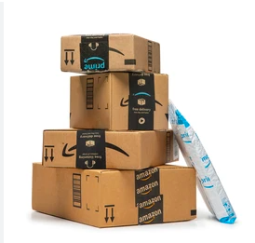
Overview
These days, there is a sea of reviews for most worthwhile product that you buy on Amazon and clicking through 500 pages of reviews is less than ideal.
As a customer, review classification and key phrase extraction can help us get a quick summary of the main pros/cons.
For product owners, review classification and key phrase extraction can be used for continuous customer satisfaction monitoring and product improvement.

Slide 3
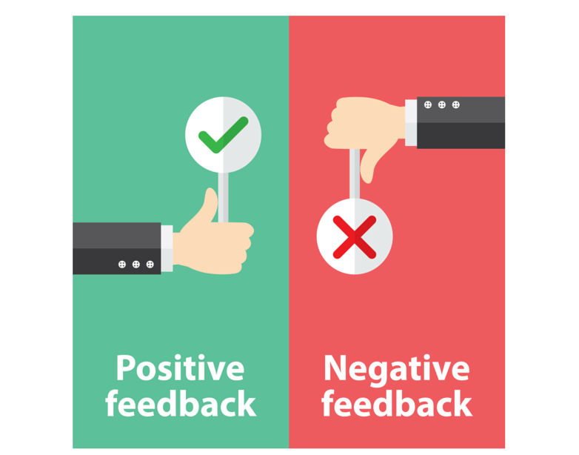
Research Question
How can we effectively and automatically split customer reviews into positive/negative?
How can we pull keywords/phrases to sum up each category?

Slide 4


The Data
The data: Amazon Review Data for Seagate 1TB Hard Drive
Data was extracted through custom API link.
There are 5,000 entries with reviews and numerical ratings (1-5).

Slide 5
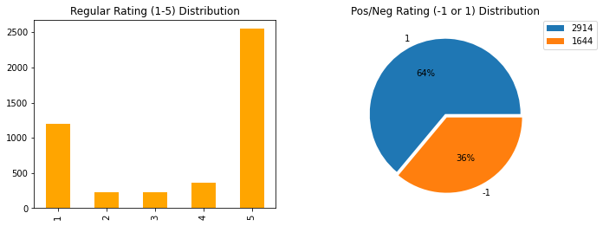
Model Construction
Creating Historical Data: Reviews with a 1-3 rating is negative and 4-5 rating is positive.
Non-english reviews were detected and removed.
Keywords/phrases will then be ranked and extracted for each positive/negative group.

Slide 6
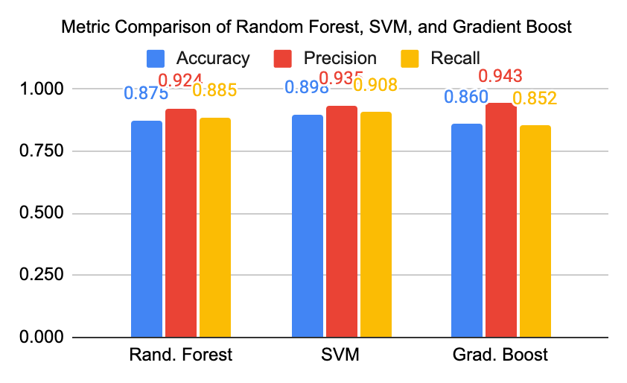
Model Comparison and Selection
Metrics Table
Metric | Rand. Forest | SVM | Grad. Boost
Accuracy | 0.875 | 0.898 | 0.860
Precision | 0.924 | 0.935 | 0.943
Recall | 0.885 | 0.908 | 0.852
Classification was trained and tested using Random Forest, SVM, and Gradient Boost.
SVM excelled across all metrics accuracy, precision, and recall and therefore is the chosen model for this data set.

Slide 7
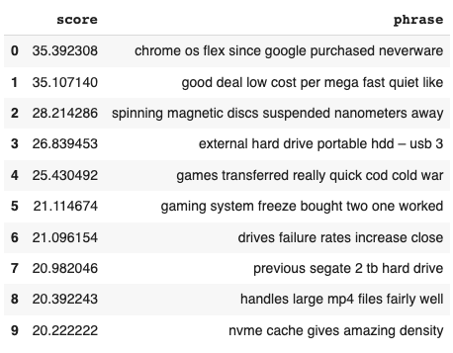
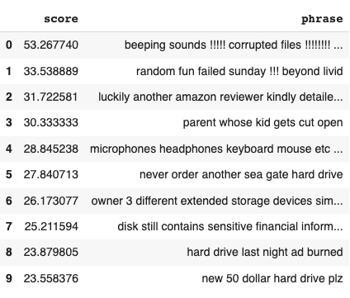
Keyword/Phrase Extraction
Positive
Negative
Top 10 scored keyword/phrases were extracted using rake-nltk on the test set.
A few reviews seem to appear in wrong group potentially due to original splitting of review ratings.
First few reviews could potentially be noise due to use of unique words.

Slide 8
Conclusion and Improvements
SVM model was selected over 2 other models. It was able to classify positive/negative reviews with accuracy, precision, and recall at .89, .93, and .90 correspondingly. Rake was then used to score and extract top 10 keywords/phrases.
The use of this tool can provide transparency to customers and help product owner in continuous product monitoring for future improvements.
Future Improvements…
(1) Test method on historical data that has positive/negative already annotated. (2) Experiment with different keyword/phrase extraction methods for better results.

